Slide 1
Navigating the New Normal in Washington State
NMTA Conference
November 9, 2011
Steve Mullin
President, Washington Roundtable

Slide 2
What is the national picture?
High unemployment
Weak consumer confidence
Economy stalled
Consumer & business confidence is weak
Stock market is volatile

Slide 3
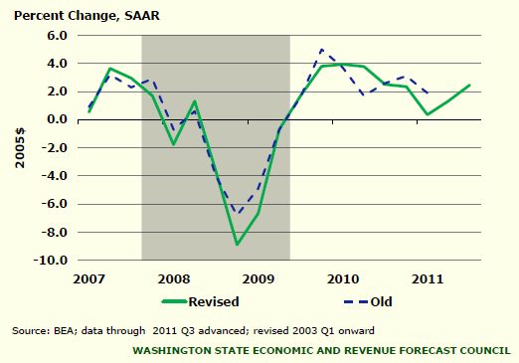
GDP revisions show economy close to stalling

Slide 4
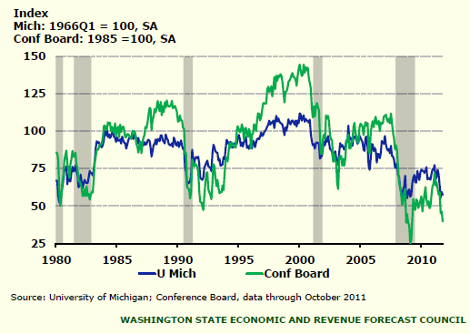
Consumer confidence is very weak

Slide 5
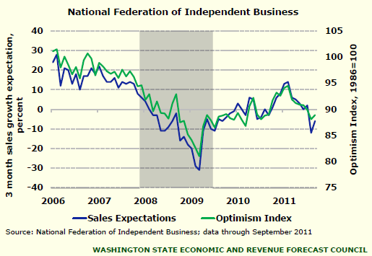
Sales expectations & small business optimism also low

Slide 6
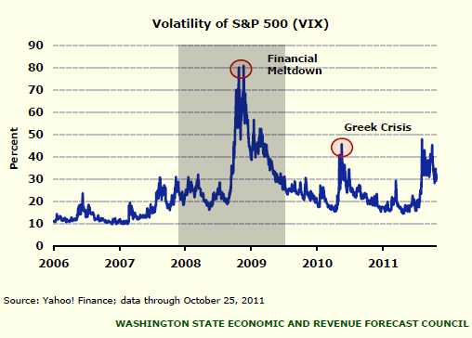
Stock market volatility spiked again

Slide 7
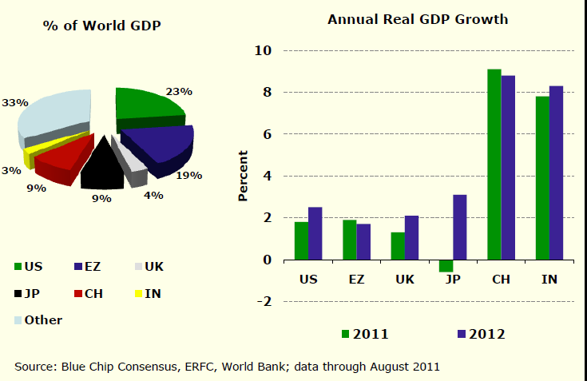
World GDP to remain weak through 2012

Slide 8
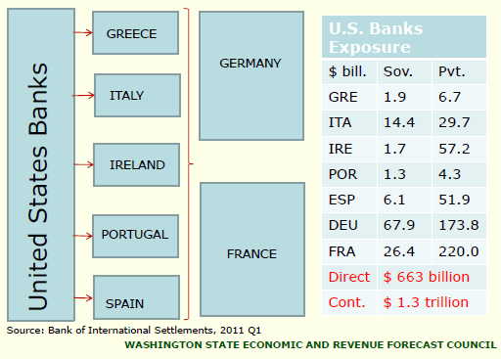
US Banks exposure to Europe is concerning

Slide 9
Washington’s economy
The troubling
The promising
Unemployment remains above 9%.
Worst downturn in non-residential construction in 30 years.
Single family home prices continue to decline.
State revenue projections have been repeatedly reduced.
Roundtable members: 2012 could look a lot like 2011.
Boeing has over 7 years of commercial orders on its books.
Software publishing employment is growing.
Export growth is strong.

Slide 10
Deepest & most persistent employment decline since WWII

Slide 11
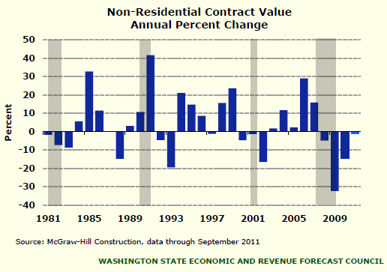
WA’s worst downturn in non-residential construction in 30 years

Slide 12
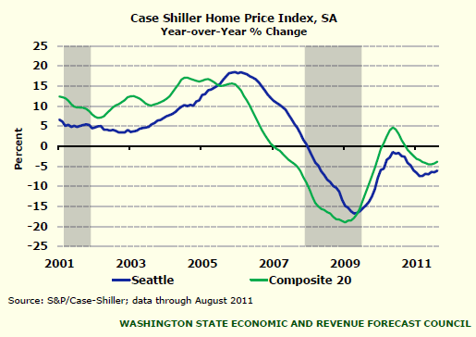
Single-family home prices continue to decline
Aug. 2011
US down 3.9%
Seattle down 6.1%.

Slide 13
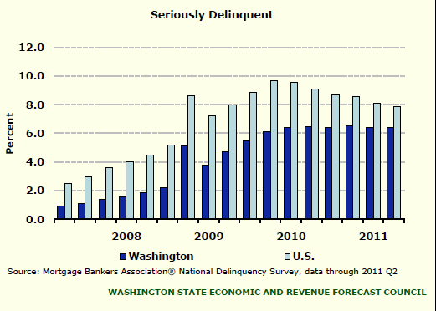
More foreclosures can be expected
WA Rank:
2011Q1: 23
2011Q2: 23
Seriously delinquent = 90+ days past due or in foreclosure.

Slide 14
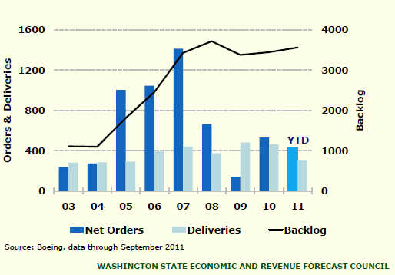
Reasons for optimism…
Boeing has over 7 years of commercial orders on its books
Excludes military’s new refueling tanker.

Slide 15
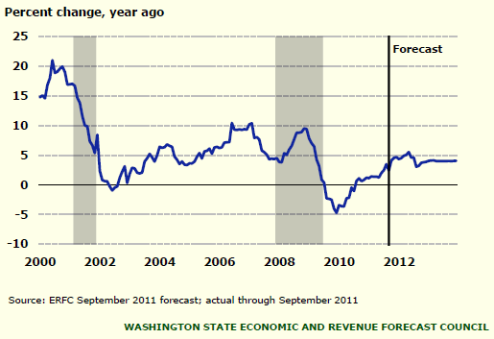
Reasons for optimism…
Software publishing employment is growing

Slide 16
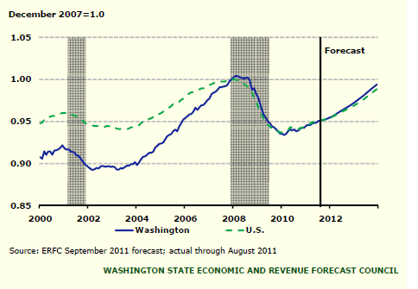
Reasons for optimism…
WA employment will recover slightly faster than US
ERFC:
WA employment peaked 1 month after U.S. (Feb. 2008 v. Jan. 2008)
Both WA & the U.S. reached a trough in Feb. 2010.
Both WA & U.S. won’t reach their previous peak until after 2013.

Slide 17
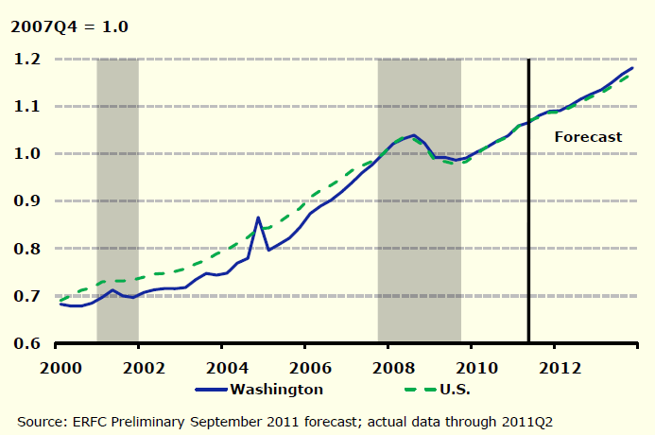
Reasons for optimism…
WA personal income will recover slightly faster than US

Slide 18
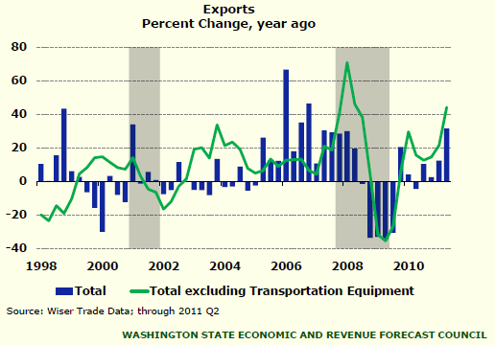
Reasons for optimism…
WA export growth is strong and will help state outperform in the recovery
Total exports were up 31.5% y/y in Q2.

Slide 19
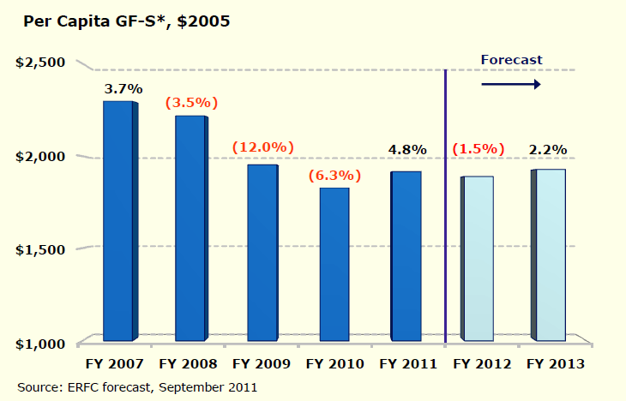
Washington:
Real per capita general fund state revenue
General Fund & Related Funds for FY 07-09. New definition for GF in FY10-13.

Slide 20
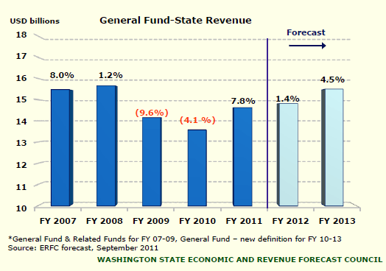
Washington:
General Fund Forecast by Fiscal Year
FY 2011 revenues were boosted by one-time transfers of non-GF0S funds into the GF-S.

Slide 21
Washington’s business climate:
What Roundtable members are saying
Outlook: guarded.
Economy:
  2012 will look a lot like 2011.
  Washington’s recovery is heavily dependent on national economy, which continues to struggle.
  Optimism / concern is sector specific – sectors that touch housing in any way are most negative.
  Bright spots: ramp up in hiring at Boeing; tech.

Slide 22
Perception of state business climate isn’t good, but getting better

Slide 23
Perception of state competitiveness improving, but long way to go
Rank Washington's competitiveness relative to other states.

Slide 24
Skeptical about WA’s commitment to job creation
Relative to efforts in other states, how committed are WA’s elected officials to doing what it takes to create/maintain jobs?

Slide 25
What can state leaders do about it?
Acknowledge the bad.
Set a vision for a positive future.
Take action.

Slide 26
Deal with the immediate crisis.
Boost confidence.
Prioritized investment
Improve competitiveness.
Workforce
Jobs.
Infrastructure
Fiscal stability
Costs

Slide 27
Long-term: Set a course for growth.
Quality
Value.
Cost
Education & workforce
Infrastructure
Innovation
Energy
Tax burden
Business costs

Slide 28

First:
Identify what constitutes success for Washington state.
BENCHMARKS for a BETTER WASHINGTON
Second:
Establish a roadmap for moving our state forward.

Slide 29
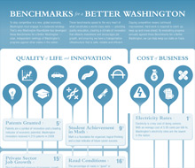
Benchmarks for a Better Washington
Look beyond just the next 2 years.
Embrace a balanced a comprehensive plan for ongoing improvement.
Commit to pursue necessary policy changes and measure progress against clear, measurable benchmarks.
Long-term success and vitality depends on a common commitment to:
  protect & enhance quality of life.
  provide employers with the competitive edge necessary to succeed in a global economy.

Slide 30
Goals:
Criteria:
Rank among the top 10 states in the nation on key quality of life and innovation metrics.
Stay or get out of the 10 states with the highest business costs.
Benchmark must speak to the idea that Washington must compete on value (quality AND cost).
Benchmark has to be measurable via recognized, reliable, independent sources that include comparative data for all 50 states.
Notes:
Our vision for Washington state rests on two complementary goals:
1. Rank among the top 10 states in the nation on quality of life and innovation metrics. Things like high school graduation rates, math and science achievement for our students, road and bridge conditions, and patent attainment.
2. Be more competitive on business costs. Being the cheapest state in the nation isn’t the goal. But we can’t be the most expensive either. Multi-state employers assess comparative business costs on a daily basis, in real time. They make investment decisions based on those assessments. Washington simply can’t afford to be among the 10 states with the highest costs.

Slide 31




BENCHMARKS for a BETTER WASHINGTON
Goal: Rank among the top 10 states for low electricity rates (industrial and commercial). | Current Rank: 1st 2009 data ranks Washington the lowest out of the 50 states with an average cost of 5.95 cents/kW-hr.
Goal: Rank among the top 10 states in the number of utility patents granted annually. | Current Rank: 4th Inventors in WA secured 5,258 utility patents in 2010, up from 4,309 the previous year (which ranked the state 5th in the nation).
Goal: Rank among the top 10 states for total private sector (non-govt.) job growth. | Current Rank: 15th Private sector job growth drives economic growth.
Notes:
Onto the benchmarks.
This first set depicts a few areas where Washington is doing well.
The state ranks 1st among the 50 states for low electricity rates – industrial and commercial. Part of that is our natural abundance of hydroelectric power. There are other policy factors at play. That said, this is a major selling point for Washington state and we must protect this competitive edge.
Patents—another area where Washington excels. Our board picked this metric because patents symbolize innovation and are an indicator of potential future economic growth. The one-pager I passed out today puts Washington at 5th in the nation based on 2009 data. We just received the 2010 data and we’ve moved up to 4th with 5,258 patents awarded to inventors in our state last year. Again this is an arena where we need to maintain our edge, fostering an environment that encourages innovation, research and entrepreneurship.
Third on this slide – total private sector job growth, These are non-government jobs. This metric speaks for itself. Jobs drive the economy. Washington currently ranks 15th among the 50 states. A respectable number, but we must shoot for better. Policies that encourage job creation – competitive business taxes, successful education and workforce development policies, and infrastructure development – will drive improvement in this ranking.

Slide 32



BENCHMARKS for a BETTER WASHINGTON
Goal: Rank among the top 10 states in high school graduation rates. | Current Rank: 42nd WA’s graduation rate in 2008 was 65.6%. More than 30,000 students fail to graduate every year; this equates to 170 students dropping out every day.
Goal: Rank among the top 10 states in student performance in math & science. | Current Rank: 9th in math; 21st in science 40% of 8th graders score at above or proficient in mathematics. 34% of 8th graders score at or above proficient in science.
Goal: Rank among the top 10 states in bachelor’s degrees awarded per capita. | Current Rank: 35th By 2018, 67% of jobs in WA will require some postsecondary training. A higher ranking is needed to ensure WA is preparing its young people for success in its economy.
Notes:
This set of Benchmarks address the quality of our state’s public education system and Washington’s ability to give young people the education they need to secure family wage jobs in our state.
The high school graduation rate is troubling—only 68 percent of Washington students graduate from high school, ranking us 35th in the nation. We’re losing nearly a third of our students. 29,000 students a year drop out statewide. And it’s happening at a time when we already know that even a high school education isn’t good enough to secure a family wage job.
We are tracking student achievement in math and science because data indicates these are the subjects where proficiency will most likely determine future academic success. Washington is doing better in math – ranked 9th nationally – and must make up ground in science – where we rank 21st nationally. We must improve.
Lastly, Washington ranks 35th in the number of bachelor’s degrees awarded per capita. That’s not to say we don’t have an educated populace, we do. But we’re importing tons of talent, from other states and other nations. We need to do a better job of educating our own young people for the jobs that will exist here in our state. The data clearly shows that by 2018, two thirds of the jobs in Washington will require postsecondary training.

Slide 33



BENCHMARKS for a BETTER WASHINGTON
Goal: Rank among the top 10 states in the lowest number of functionally obsolete bridges. | Current Rank: 42nd 21% of WA bridges are functionally obsolete; only 8 states have a higher percentage of FO bridges.
Goal: Rank among the top 10 states for the highest % of roads in “good or very good” condition. | Current Rank: 16th 48.2% of Washington’s roads are deemed in “good” or “very good” condition.
Goal: Rank among the top 10 states with the shortest commute travel times per person. | Current Rank: 39th Average commute time to work of 25.5 minutes. (The commute is longer along that I-5 corridor at 27.1 minutes.)
Notes:
These goals address our state’s infrastructure—namely, transportation. As you know, the Roundtable has long been an advocate of transportation improvement, recognizing that an efficient system is essential for commerce and the safe flow of people and goods.
Washington has a lot of ground to make up.
Our state ranks 42nd in the percent of bridges deemed functionally obsolete. Meaning, only 8 states have a higher percentage of functionally obsolete bridges.
We rank 16th in the percent of roads in “good” or “very good” condition. So our roads are considerably better than our bridges, but improvements are still needed to become a top 10 state.
We rank 39th in average commute times, which probably isn’t a surprise to anyone in this room.
To crack the top 10 in these categories, Washington must invest in its transportation infrastructure – construction, maintenance and preservation. The next statewide transportation investment package is on the horizon. Something on which we’ll continue to work closely with the Chamber and our other Transportation Partnership partners.

Slide 34



BENCHMARKS for a BETTER WASHINGTON
Goal: Get out of the 10 states with the highest UI tax rates. | Current Rank: 46th 45 states have lower UI tax rates. The average rate per full-time employee in WA is $491; 300% of the national average.
Goal: Get out of the 10 states for highest workers’ comp benefits paid. | Current Rank: 50th The state’s workers’ compensation benefits are the highest in the nation, 91% higher than the US average.
Goal: Stay out of the 10 states with highest state/local business tax burden relative to private sector GSP. | Current Rank: 37th State and local business taxes equate to 5.4% of private sector GSP, earning Washington the ranking of 37th. Only 13 states have a higher business tax burden.
Notes:
Lastly, the cost benchmarks. As I said earlier, we aren’t pushing for Washington to be the cheapest state in the nation, but we can’t keep coming in among the 10 most expensive either.
The legislature made progress this year with unemployment insurance reform – capping the social tax and avoiding another round of double-digit increases on employers. We’re hopeful we’ll see the positive impacts of that legislation move the needle on this cost metric. In the short run, it’ll go a long way to improve employer confidence and competitiveness.
We’re still working hard in Olympia to make commensurate progress on workers’ compensation reform, namely, allowing for voluntary settlements options. This is the only proposal out there that will reduce the long-term cost curve.
Lastly, Washington is in a three-way tie for 38th when assessed on the business tax burden. We’re not among the 10 most expensive states—which is good—but we are right on the edge.

Slide 35
Fiscal policy:
  Focus on sustainable spending.
  Maintain reserve = to 5% of GF expenditures.
  Establish defined contribution pension plan for new hires.
  Reinstate firm expenditure limit
  Better manage debt service
Business costs
  Refrain from expanding UI benefits.
  Adopt mainstream voluntary settlement option.
  Establish precise definition for occupational disease.
  Permit private insurers to offer workers’ compensation policies.
A year-long partnership to research and promote a series of actionable and substantive policy recommendations that, if enacted, will preserve essential services, lay a foundation for sustainable economic growth and create an environment in which Washingtonians can thrive.
Key recommendations:
Establish a public policy foundation for economic vitality.
Reset state spending to a sustainable level.

Slide 36
Competitive Sourcing
  Ensure contracting out authority isn’t subject to collective bargaining.
  ID opportunities to reduce costs through competitive contracting.
  Create commission
Health Care
  Continue to seek Medicaid waivers to gain maximum flexibility.
  Collective bargaining: negotiate a benefits agreements approaching private sector parity.
Government restructuring
  Pursue agency consolidation.
A year-long partnership to research and promote a series of actionable and substantive policy recommendations that, if enacted, will preserve essential services, lay a foundation for sustainable economic growth and create an environment in which Washingtonians can thrive.
Key recommendations:
Establish a public policy foundation for economic vitality.
Reset state spending to a sustainable level.

Slide 37
Regulatory reform
  Adopt EPA standards, exceeding them only when justified.
  Create a permanent task force monitoring leg. & gov. rule-making.
  Exempt minor projects from the SEPA process.
Economic Development
  Expand STEM education & enhance accountability.
  Use new four-tier evaluation system to guide K-12 personnel decisions.
  Make performance primary criterion in teacher layoffs.
  Preserve access to higher education.
  Retain tax incentives the promote investment & job creation.
  Preserve tolling to support transportation investments.
A year-long partnership to research and promote a series of actionable and substantive policy recommendations that, if enacted, will preserve essential services, lay a foundation for sustainable economic growth and create an environment in which Washingtonians can thrive.
Key recommendations:
Establish a public policy foundation for economic vitality.
Reset state spending to a sustainable level.

Slide 38
Priorities for the short-term: 2012
Prioritize state spending & ensure budget sustainability.
Ensure business costs & regulatory policies are competitive.
Invest in an efficient & safe transportation system.
Support student achievement.
Protect higher education.

Slide 39
Priorities for the long-term
Make Washington a top 10 state in quality of life and innovation.
Ensure our state isn’t one of the most expensive for business.

Slide 40

Questions?
www.waroundtable.com
@waroundtable on twitter
www.facebook.com/washingtonbenchmarks

